Slide 1
Transposons
buffer distruptive
transpositions
caused by
carry
Defense mechanism
cassettes
Increased genome size
spreads
helps competion
and defense on
correlates with
Particle-associated lifestyle
A deep-ocean microbial community

Slide 2
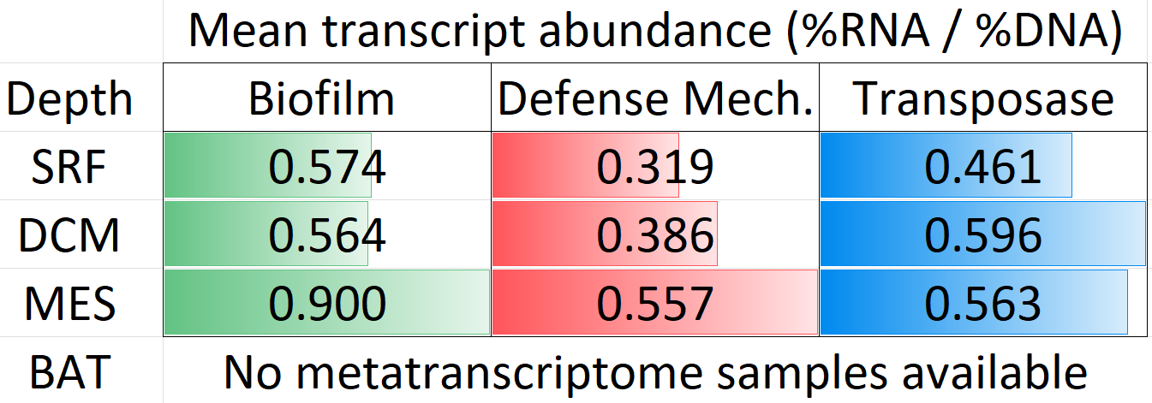
ns
]
**
***
]
]

Slide 4
correlates with
Particle-associated lifestyle
helps competion
and defense on
Increased genome
size
Defense
mechanism
cassettes
spreads
buffer distruptive
transpositions
cause by
carry
Transposons
A deep-ocean microbial community

Slide 5
Transposons
spreads
carry
helps competion and defense on
The switch to particle lifestyle
Defense
mechanism
cassettes
A deep-ocean microbial community

Slide 6
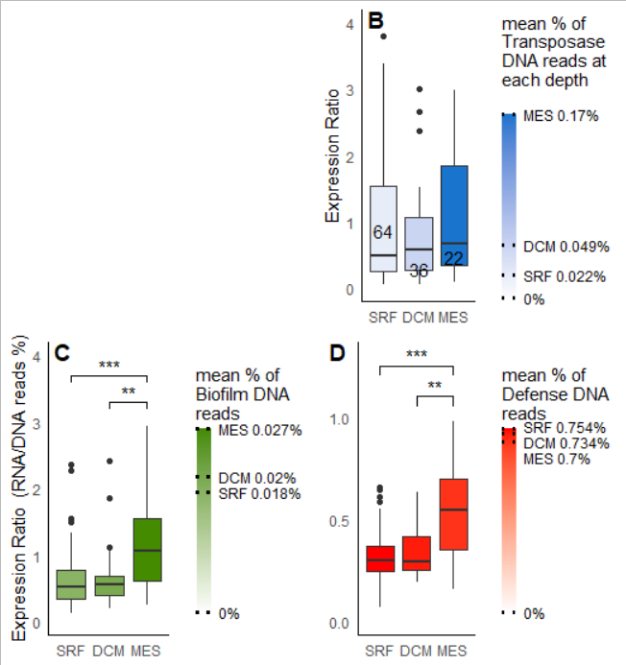

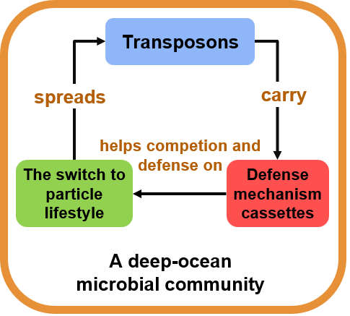

Slide 7
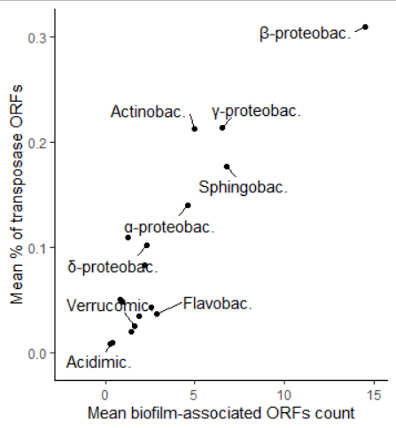
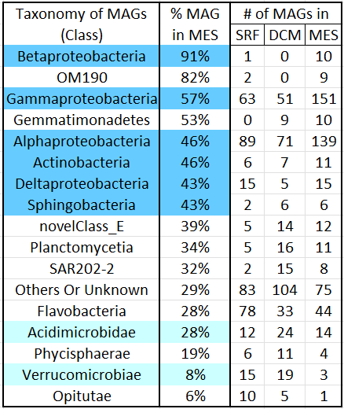
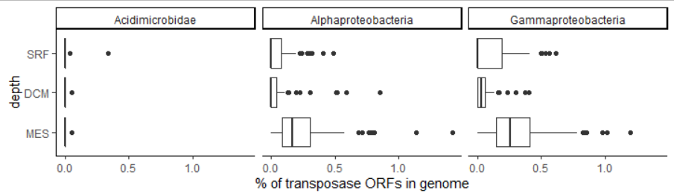







Slide 8
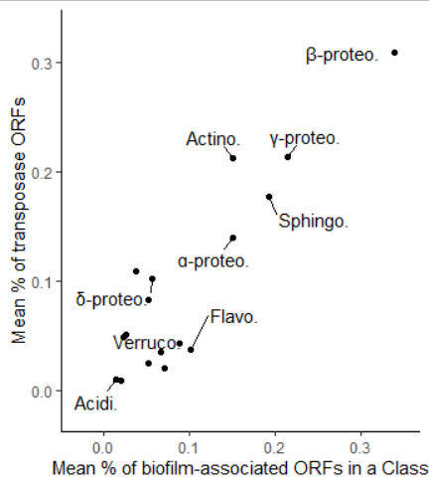







Slide 9
